Slide 1
Computer Network
Internet and Its Services

Slide 2
What is Internet?
The internet is a network of computers linking many different types of computers all over the world.
It is a very large wide area network (WAN) connecting computers and networks around the world.
It makes it possible for millions of users to connect to one another via telephone lines, cable lines and satellites.

Slide 3
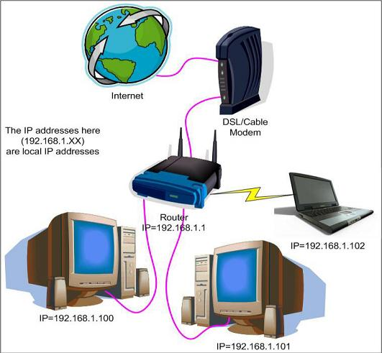
Internet

Slide 4
How did the Internet developed?
Internet was born in late 1960’s
The internet has its root in the ARPANET system of the Advanced Research Project Agency of U.S. Department of Defense which linked together mainframe computers to form a communication networks.
ARPANET is known as the forefather of internet.

Slide 5
Advantages and Disadvantages
The internet has many more advantages than it does disadvantages according to research.
Advantages:
Allows easy and quick access to information
Enables user to access files and information from any computer anywhere in the world
People can check financial information, purchase products, talk to people and much more online
Downloading music- quick and easy
User can send information quickly from computer to computer

Slide 6
Advantages and Disadvantages
Disadvantages:
It promotes violence and bad behaviour within society, as it contains violent videos and other disturbing images
It can encourage negative activities such as pornography and paedophilia, these things can now be explored more openly due to the internet
It stops children from going out, as they wish to stay home and use the internet to talk to friends etc

Slide 7
Services of internet
Electronic mail
FTP
Telnet
Usenet news
The World Wide Web
URL
IRC
Search Engine
Social Networking
E-commerce
Blog

Slide 8
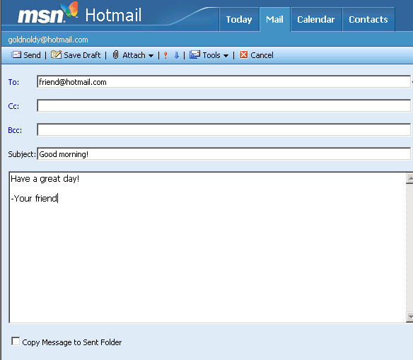
Electronic mail
Electronic mail is probably the most popular and widely used internet service.
It is also known as e-mail in short
It enables to send and receive a mail (message).
It is Faster than paper mail.
Images, audio, video can be sent along with text.

Slide 9
File transfer Protocol (FTP)
It enables users to move a file from one computer to another computer.
A file may contain:
Text document
Image
Artwork
Movie
Sound
Software

Slide 10
Telnet
Telnet service enables users to login to another computer on internet from their local computer for using:
Computing power of remote computer
Software on remote computer
Database of remote computer
This action is called ‘remote login’.

Slide 11
Usenet News
Usenet news service enables a group of internet users to exchange their views, ideas, information on some common topic of internet.
A newsgroup is like a large notice board accessible to all members belonging to the group.
2 types of newsgroups:
Moderated
Non-moderated

Slide 12
The World Wide Web
It is a most popular method of accessing internet.
It uses a concept called hypertext.
Hypertext documents on internet are known as web pages.
Web pages are created by using a special language called Hyper Text Markup Language (html)

Slide 13
URL [Uniform Resource Locator]
The Uniform Resource Locator was created in 1994 by Tim Berners-Lee to access data from the World Wide Web. A URL is a type of Uniform Resource Identifier (URI), which is the generic term for all types of names and addresses that refer to objects on the World Wide Web.
Any Uniform Resource Locator like "http://abc.com/xyz.html" can contains the following information:
Name of the site i.e. “abc.com"
Type of service the resource is served by i.e. "http"
The format of the document i.e. in this case "html"
The location of the resource i.e. " http://abc.com/xyz.html "
The protocol used i.e. ftp., www., smtp., etc.

Slide 14
IRC (Internet Relay Chat)
Internet Relay Chat (IRC) is an application layer protocol that facilitates communication in the form of text.
The chat process works on a client/server networking model.
IRC clients are computer programs that a user can install on his or her system.

Slide 15
Search Engine
Search Engine are programs that search documents for specified keywords and return a list of a documents where the keywords were founds.
Search Engines are used for searching information on the Internet.
Some of the popular Search Engines are:
Google
Yahoo
Bing

Slide 16
Social Networking
Social networking establishes interconnected Internet communities that help people make contacts that would be good for them to know, but that they would be unlikely to have met otherwise.
Social networking sites allow help strangers connect, based on shared interests or views or common language or religion or nationality-based identities.
Facebook and Twitter are popular social networking sites.

Slide 17
E-Commerce
The process of shopping done over the internet is called online shopping or E-shopping or E-Commerce.
It is very popular amongst users because it is more efficient than physically going into stores.
The internet provides the environment where shoppers’ demands are fulfilled.
Using the Internet, a shopper can scrutinize the product’s prices from various stores sitting at one place.

Slide 18
Blog
A blog is a website that allows users to share opinions and discuss various topics in the form of an online journal.
A blog is normally a single page of entries. There may be older entries but the “main page” is what people would like to see.
A blog is organised in reverse-chronological order, from the most recent entry to the least recent.

Slide 19
Uses of the Internet ?
On-line communication
Software sharing
Exchange of views on topics of common interests
Posting of information of general interests
Product promotion
Feedback about product
Customer support service
On-line journals and magazines

Slide 20
Netiquette
Netiquette is a set of rules for behaving properly online.
There are Ten rules of Netiquette that everyone who goes online should follow.
Netiquette is a network etiquette, the do's and don'ts on online communication.

Slide 21
10 BEST RULES OF NETIQUETTE
The Golden Rule - Treat others as you would like to be treated.
NO Flaming - FLAME is a personal insult communicated through the internet.
Don’t Type in ALL CAPS
Don’t Spam
Don’t talk with people you do not know
Obey Copyright Laws
Use Proper Grammar and Spelling
Be HONEST / Be Yourself
Follow the TOS [Terms of Service]
Shop Secure Sites

